Slide 1
BOOK MANAGEMENT WEBSITE OUTPUT
CHARUHASINI K

Slide 2
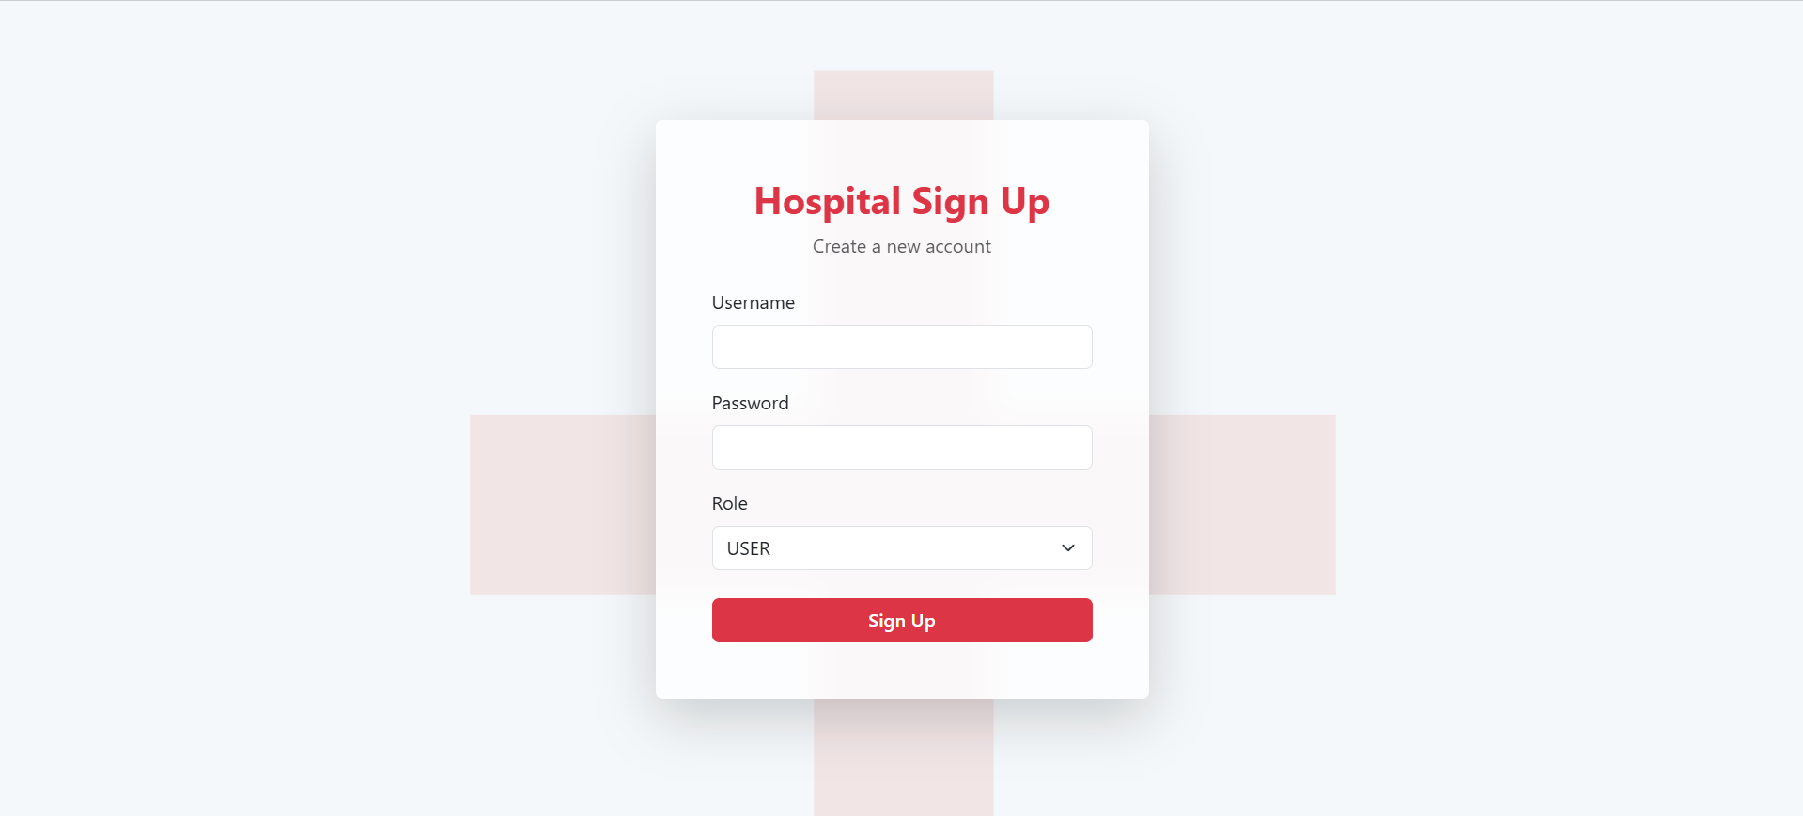
SIGNUP PAGE:

Slide 3
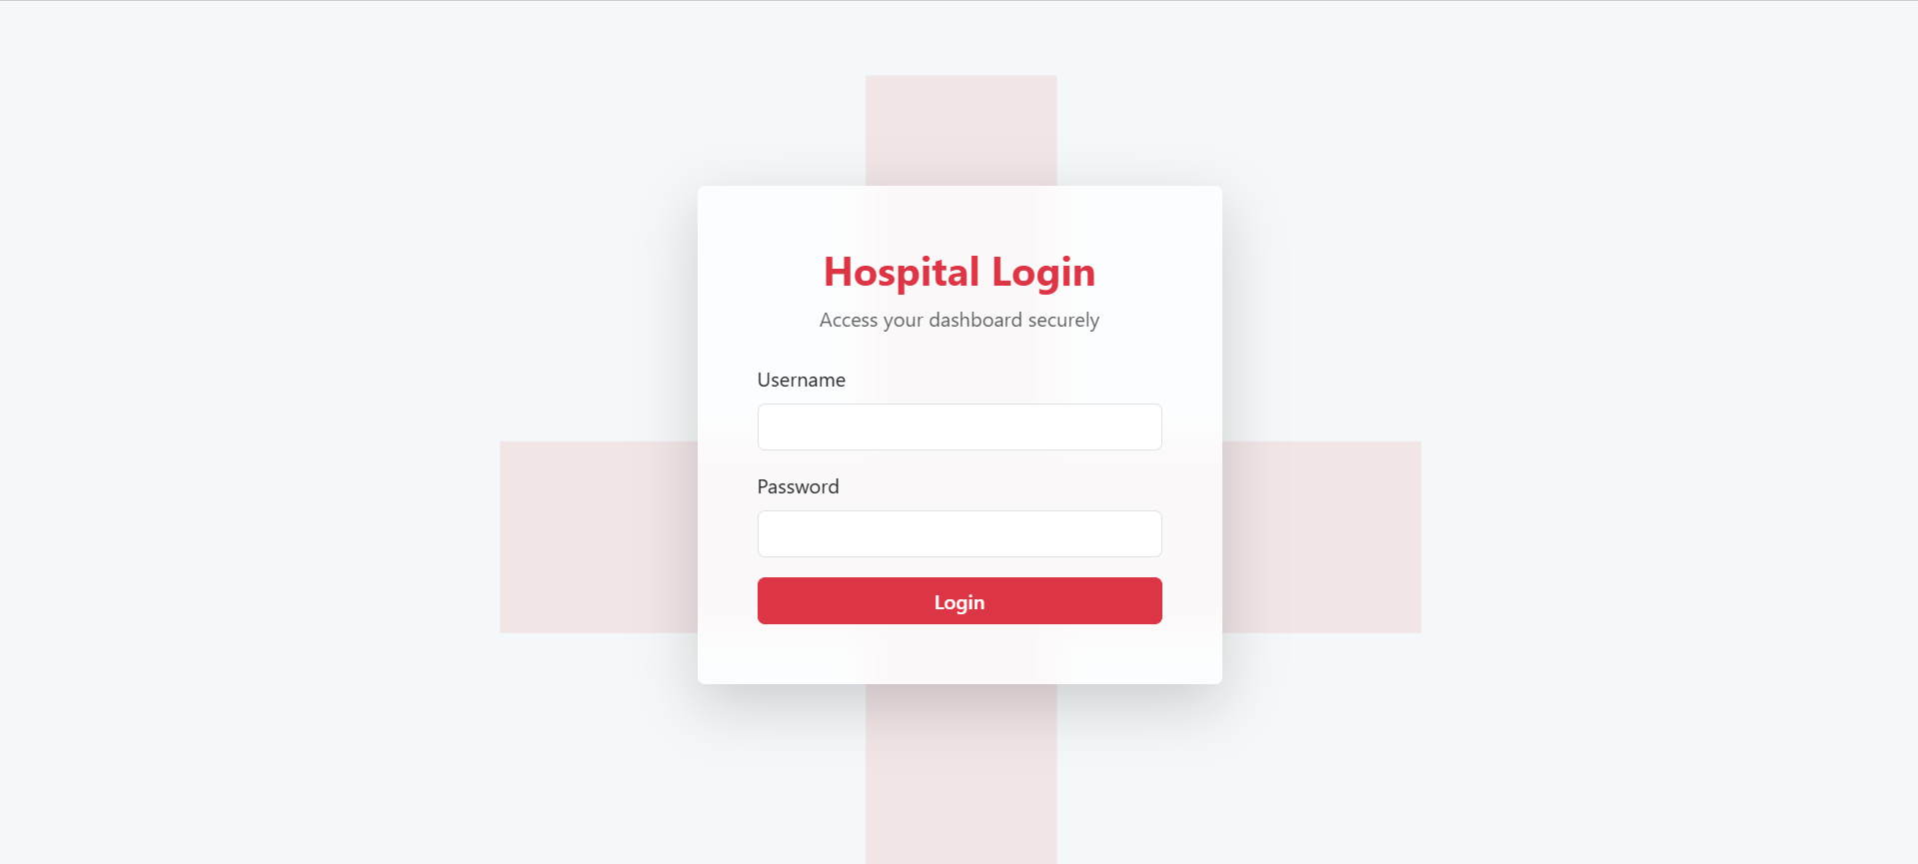
LOGIN PAGE:

Slide 4
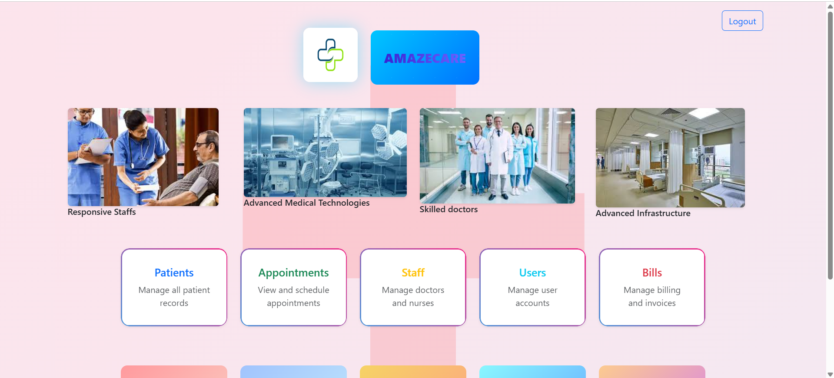
HOME PAGE:

Slide 5
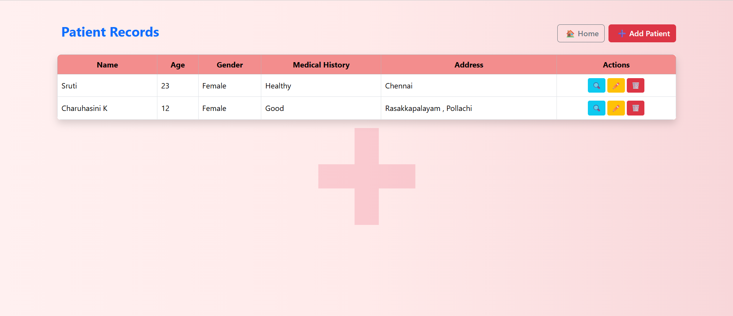
PATIENTS RECORD PAGE:

Slide 6
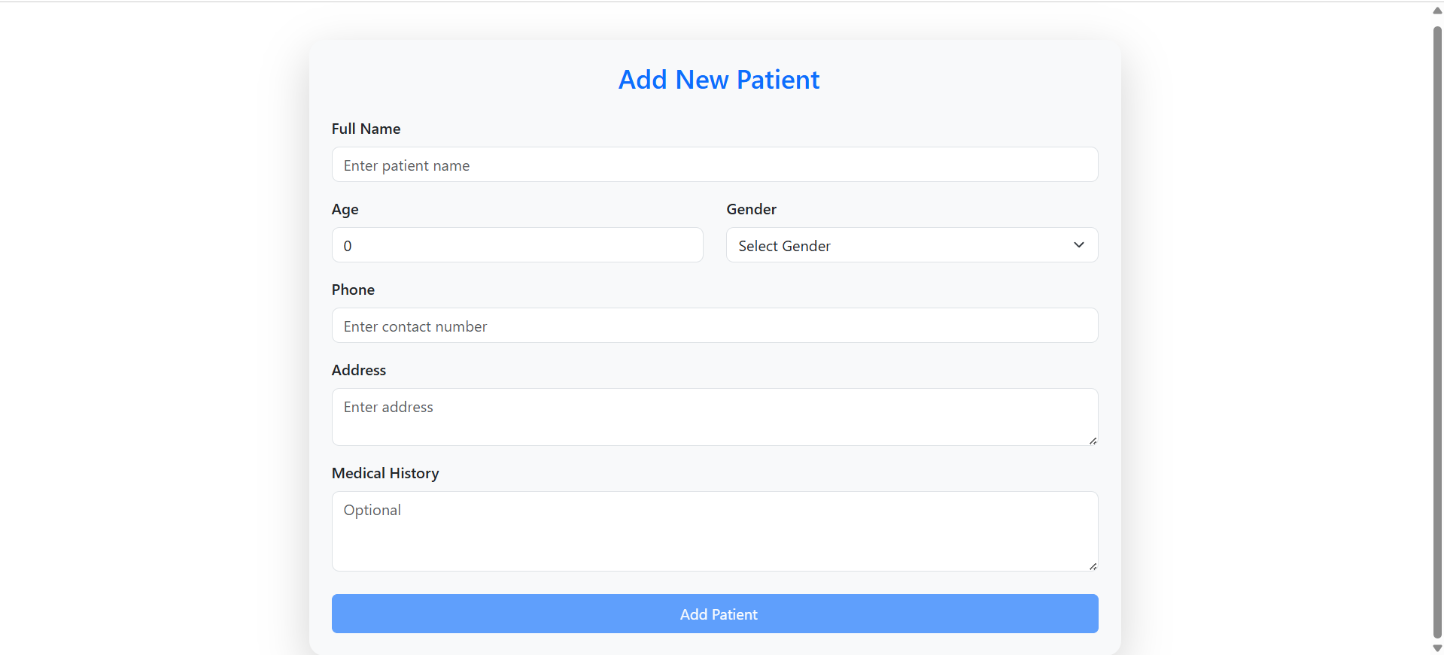
ADD NEW PATIENTS PAGE:

Slide 7
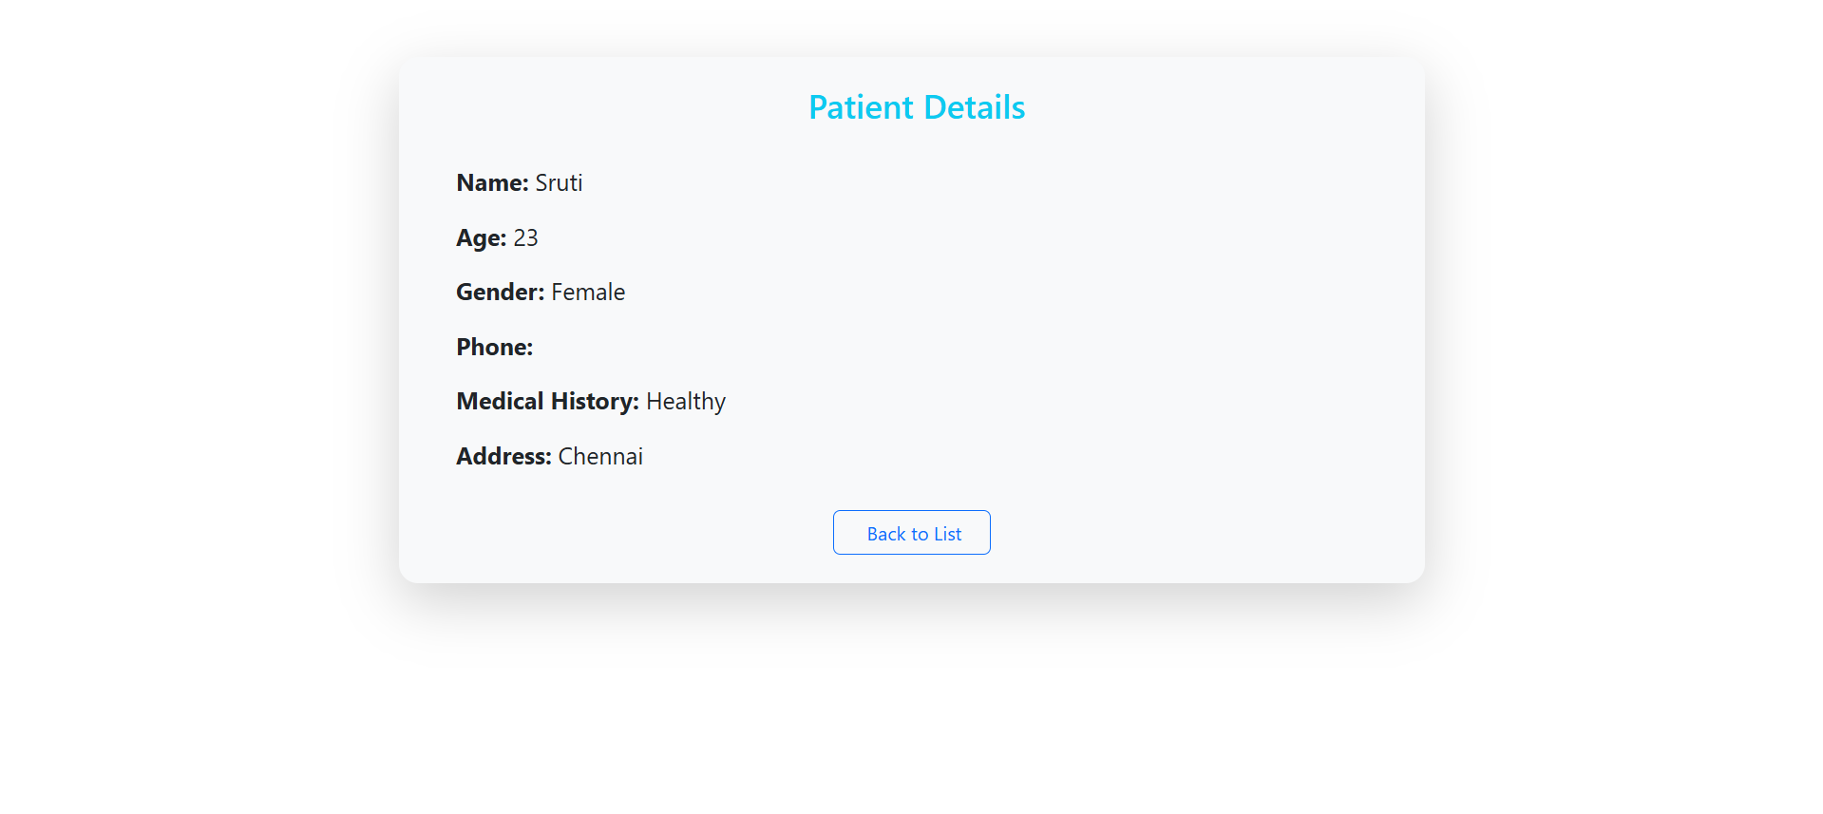
PATIENT DETAIL PAGE:

Slide 8
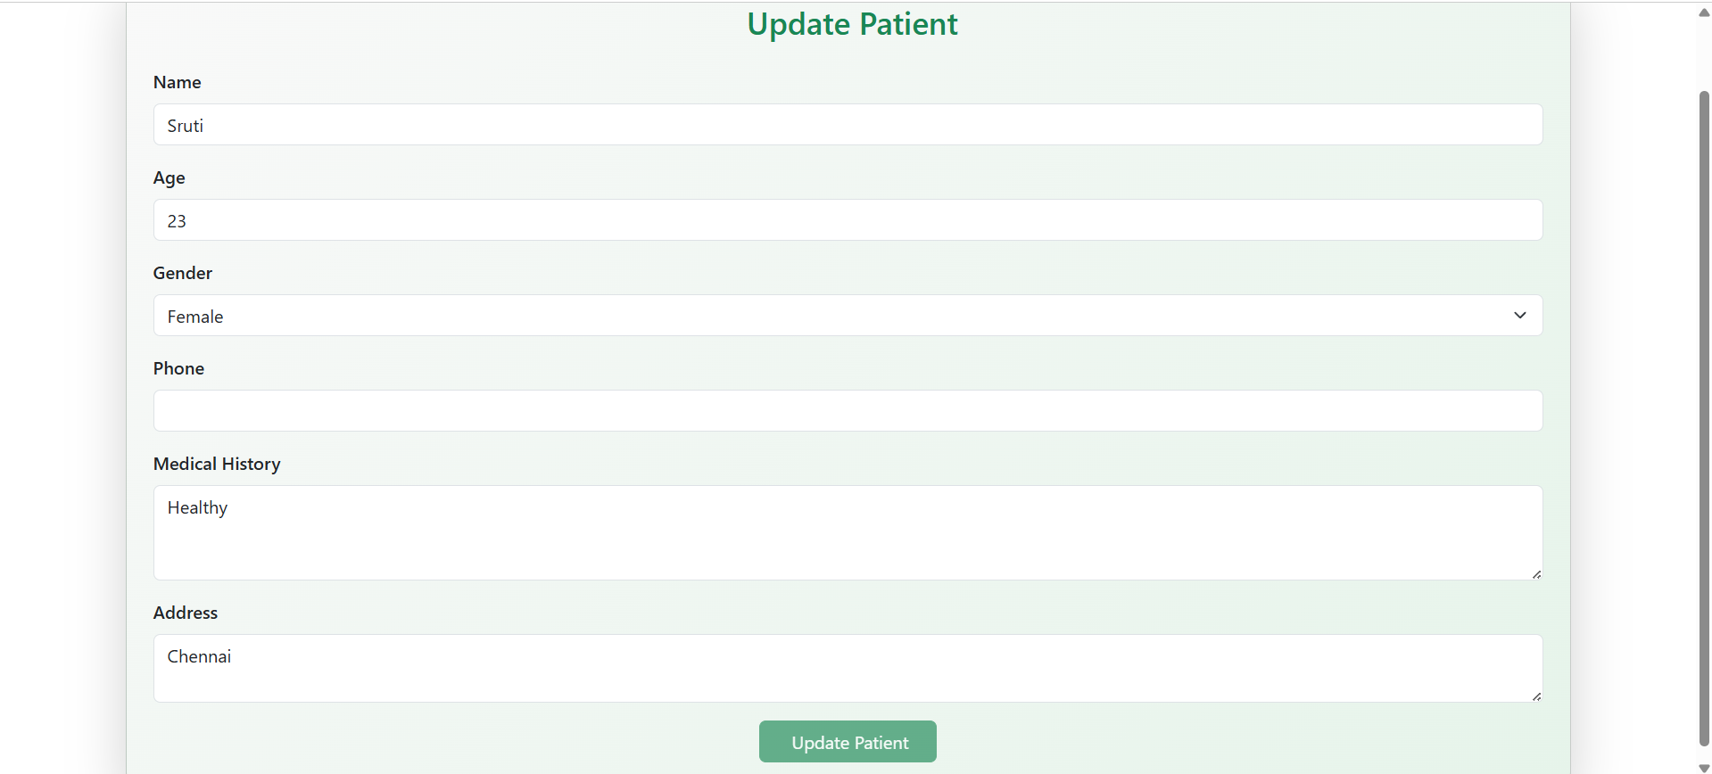
EDIT PATIENT PAGE:

Slide 9
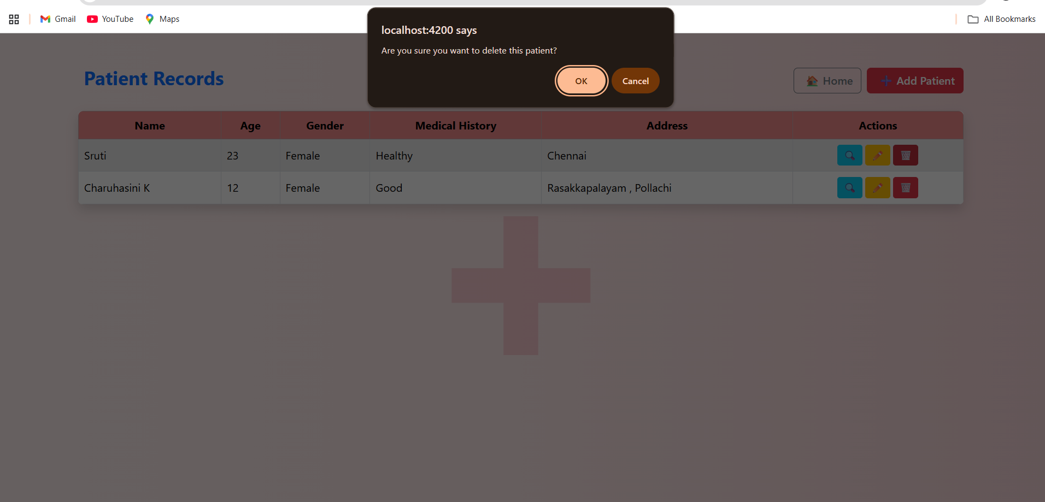
DELETE PATIENT PAGE:

Slide 10
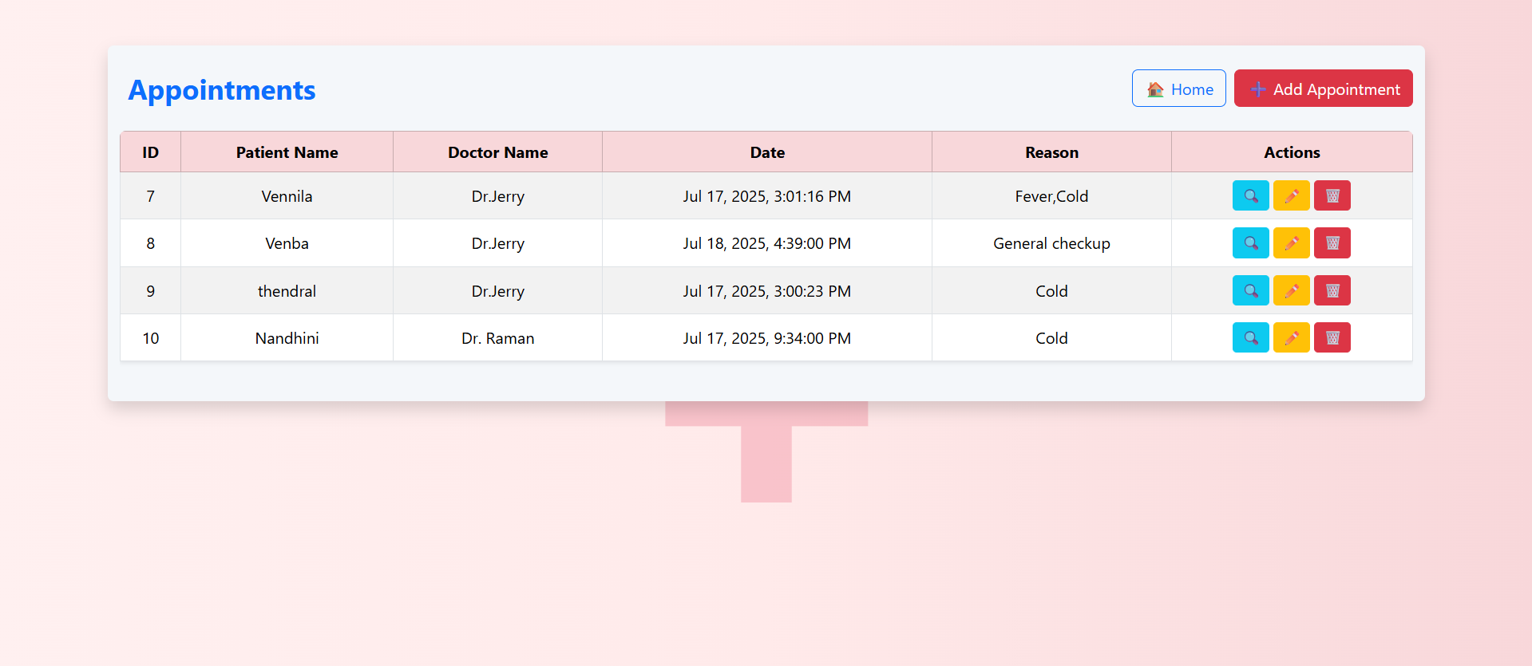
APPOINTMENTS RECORD PAGE:

Slide 11
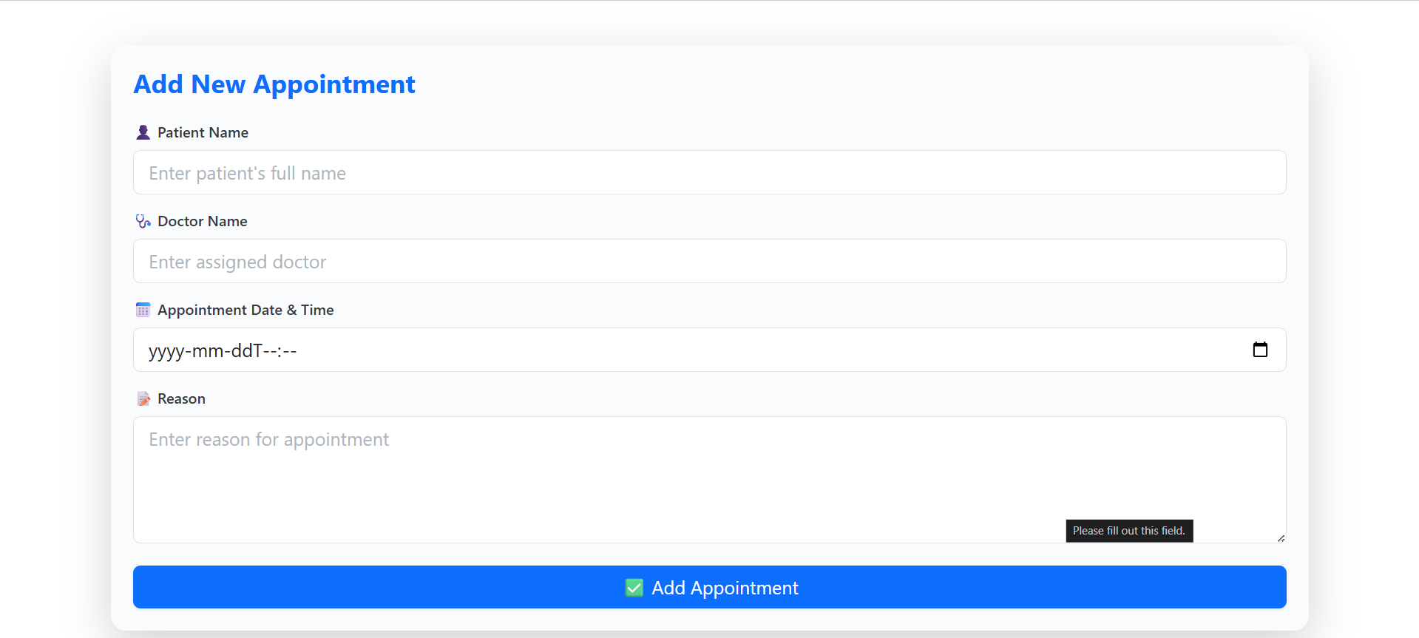
ADD NEW APPOINTMENT PAGE:

Slide 12
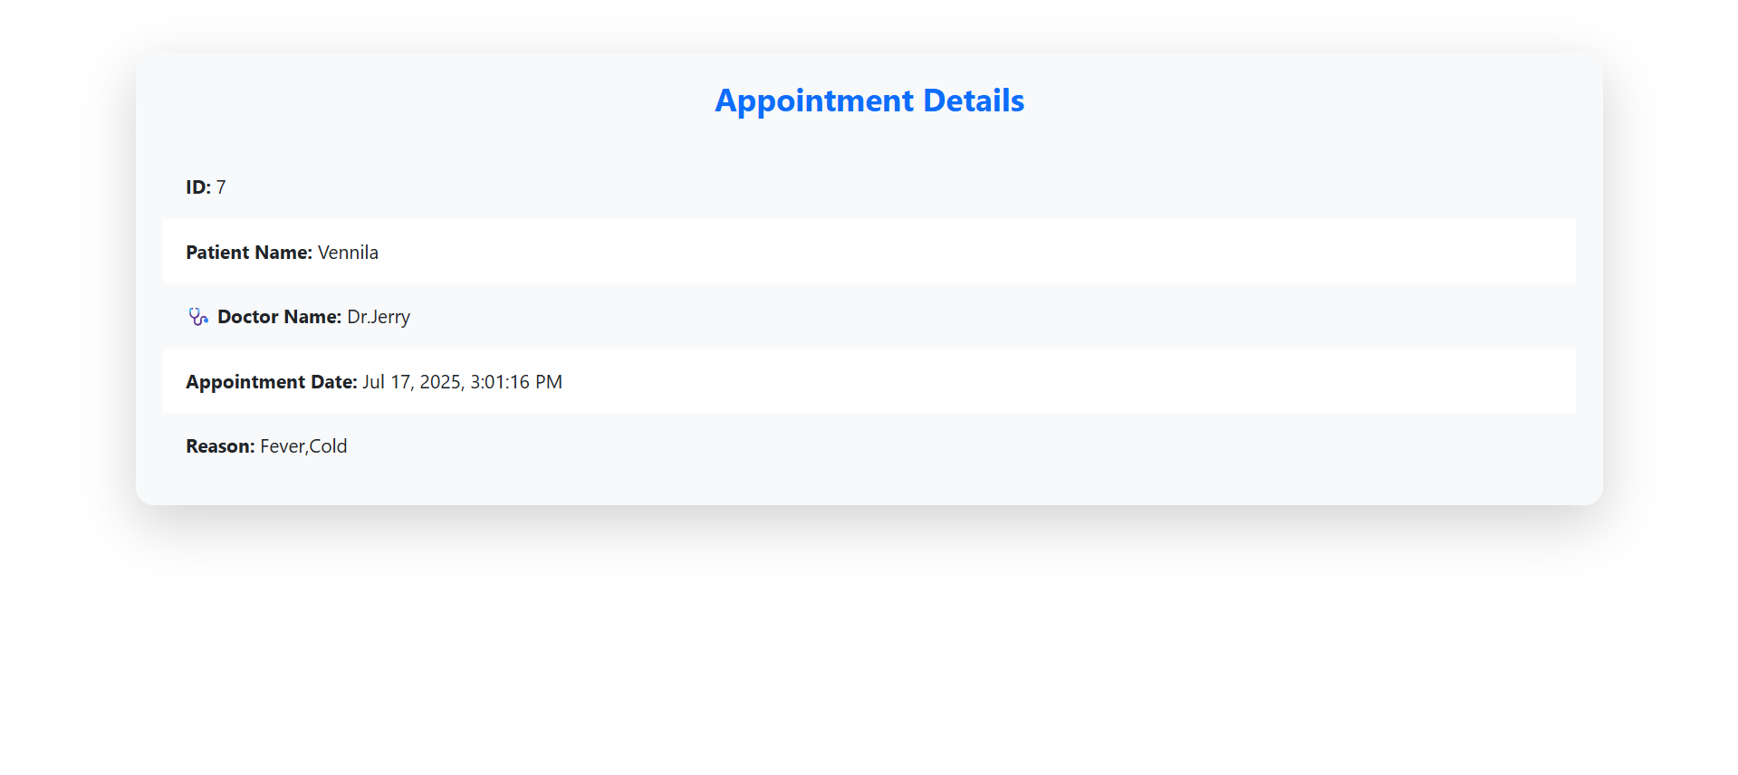
VIEW APPOINTMENT PAGE:

Slide 13
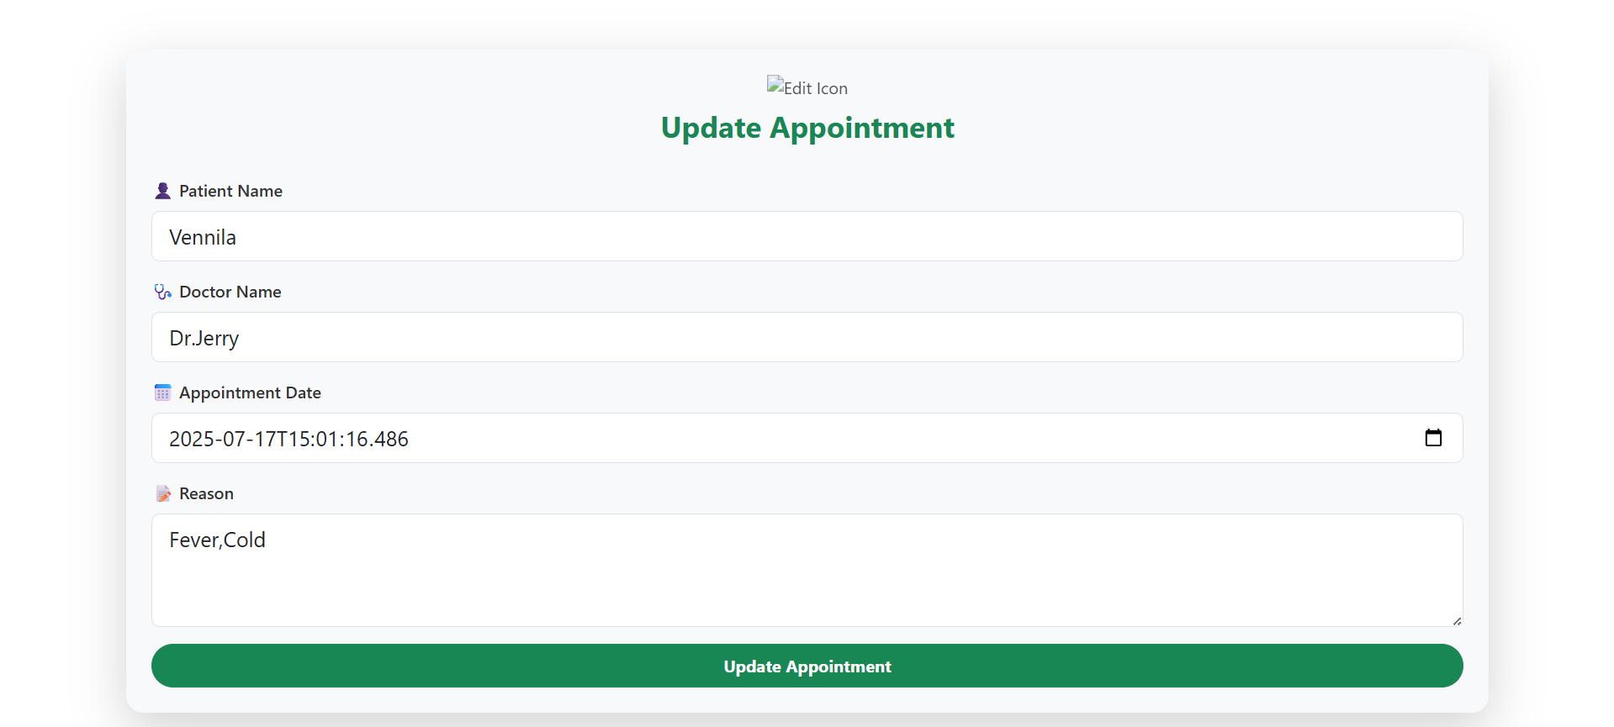
EDIT APPOINTMENT PAGE:

Slide 14
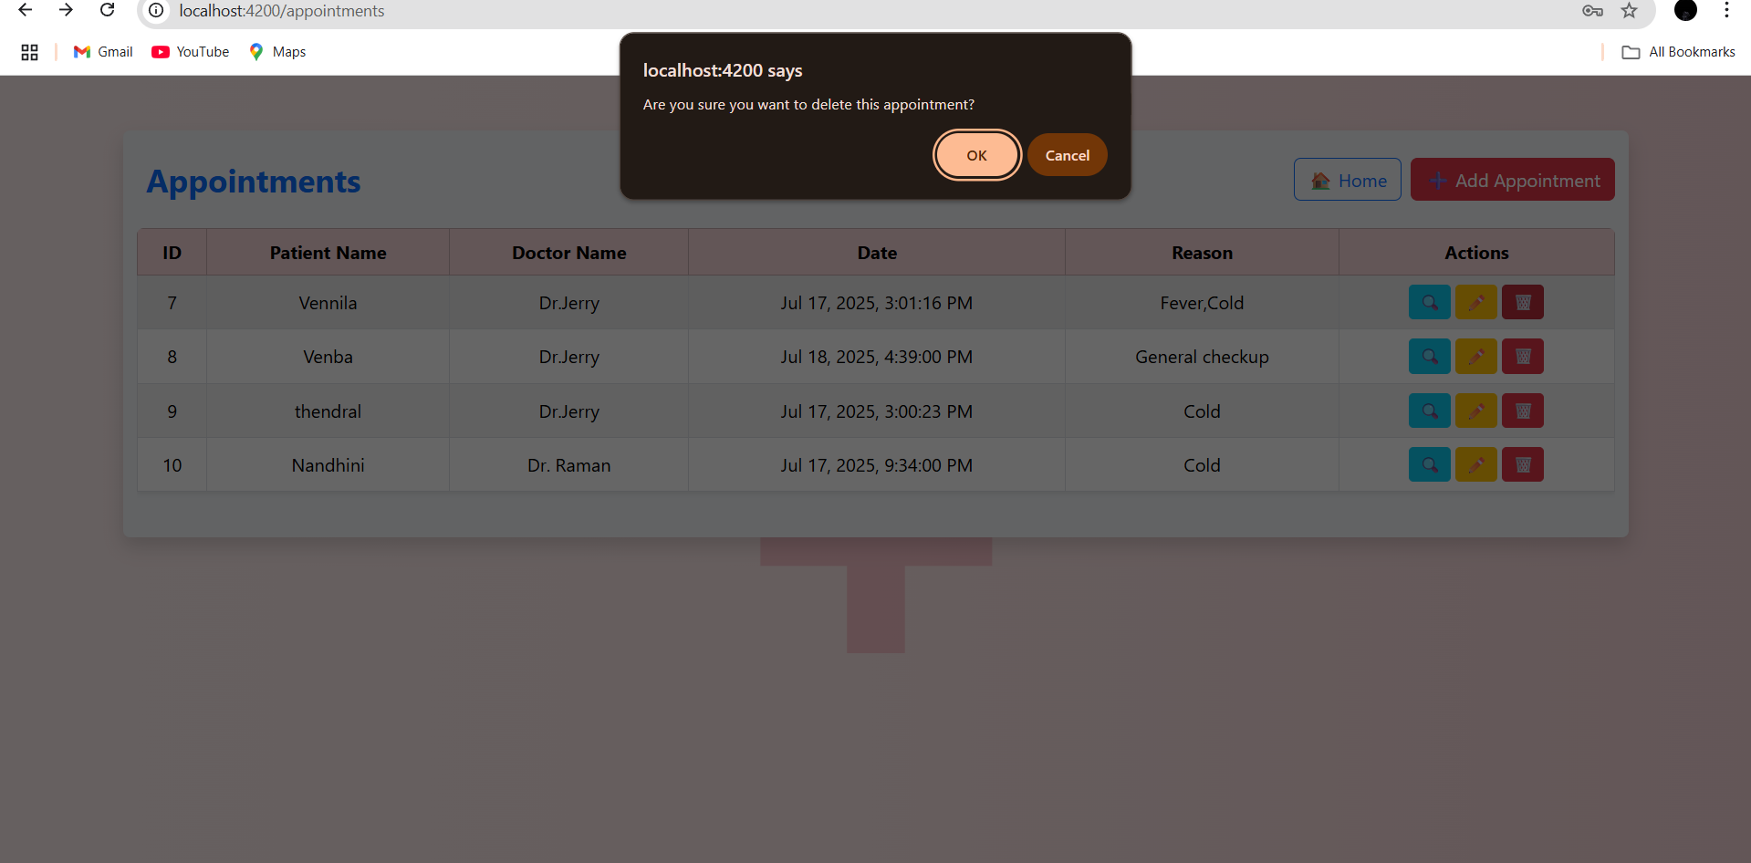
DELETE APPOINTMENT PAGE:

Slide 15
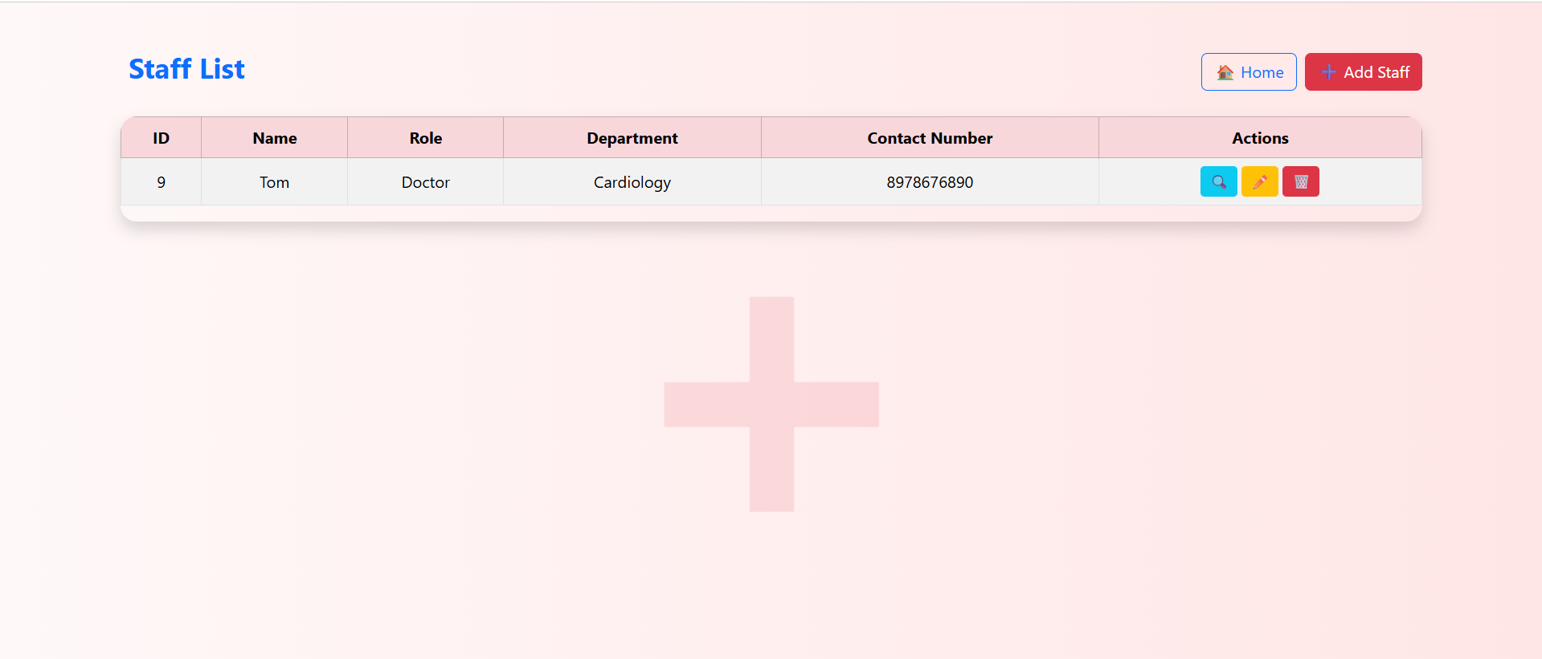
STAFF RECORD PAGE:

Slide 16
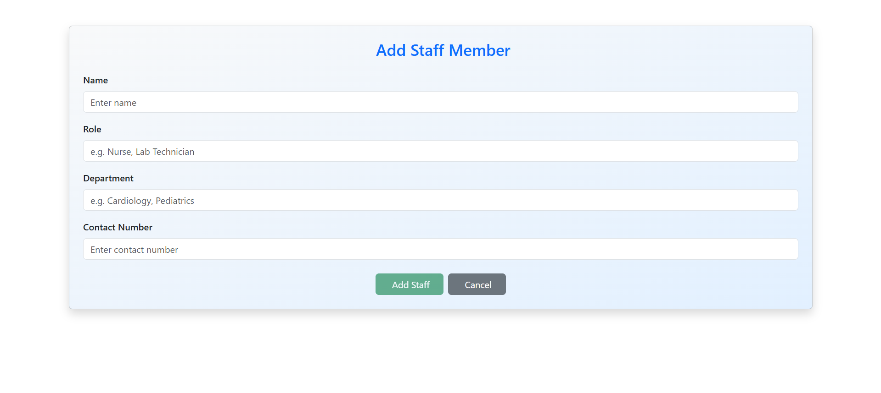
ADD NEW STAFF PAGE:

Slide 17
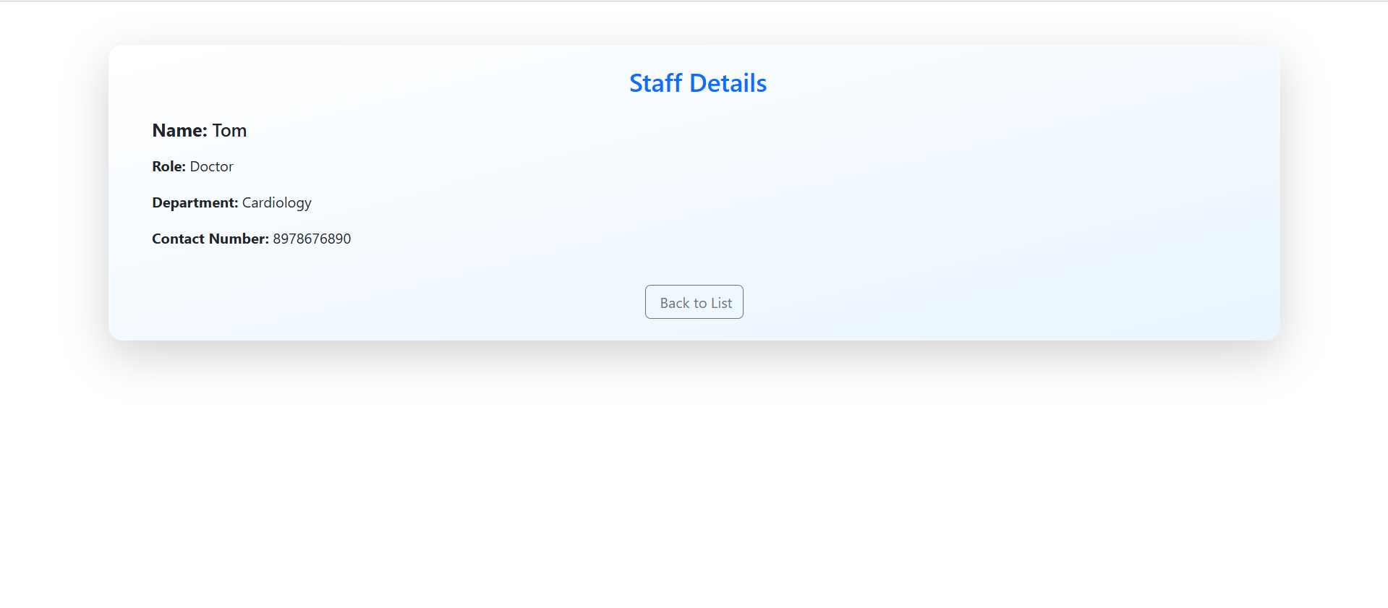
VIEW STAFF PAGE:

Slide 18
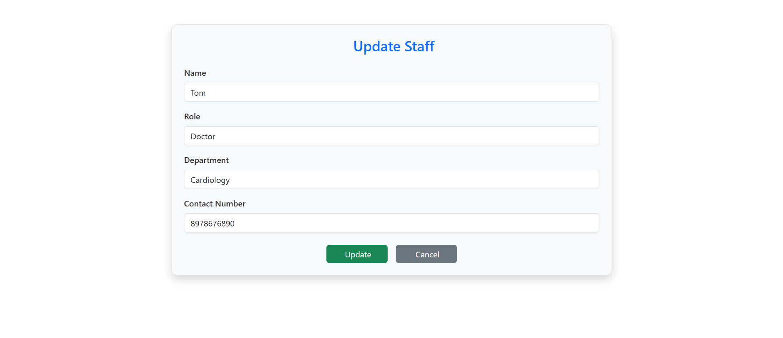
EDIT STAFF PAGE:

Slide 19
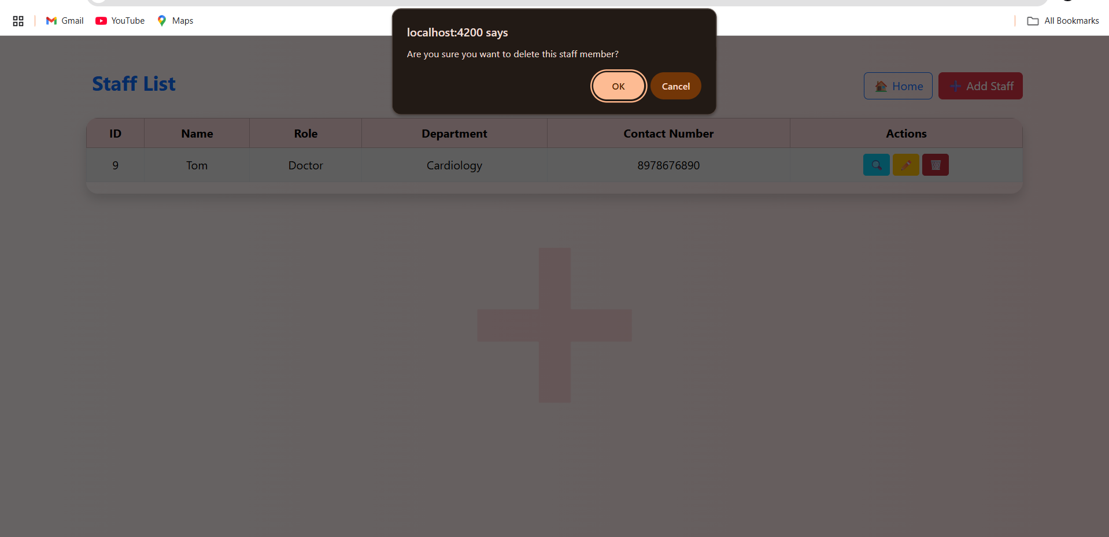
DELETE STAFF PAGE:

Slide 20
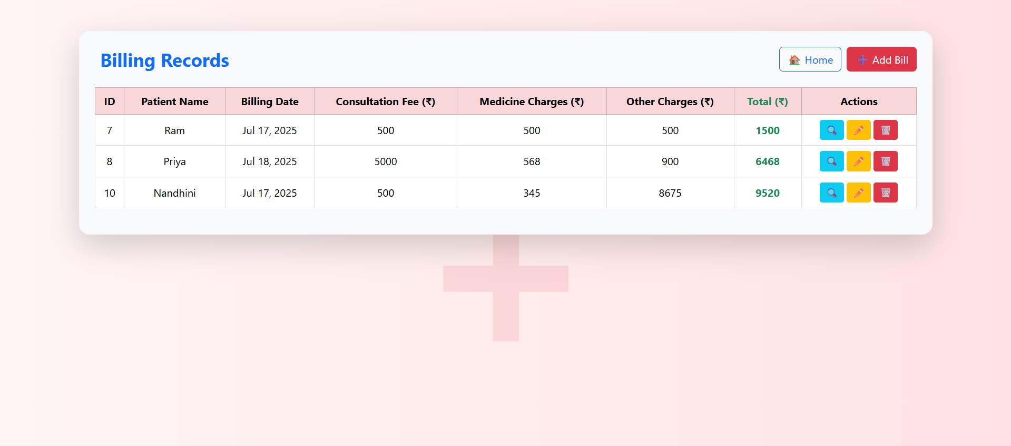
BILLS RECORD PAGE:

Slide 21
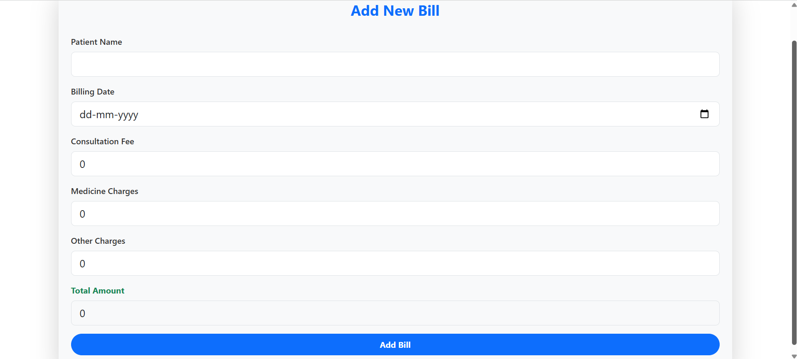
ADD NEW BILL PAGE:

Slide 22
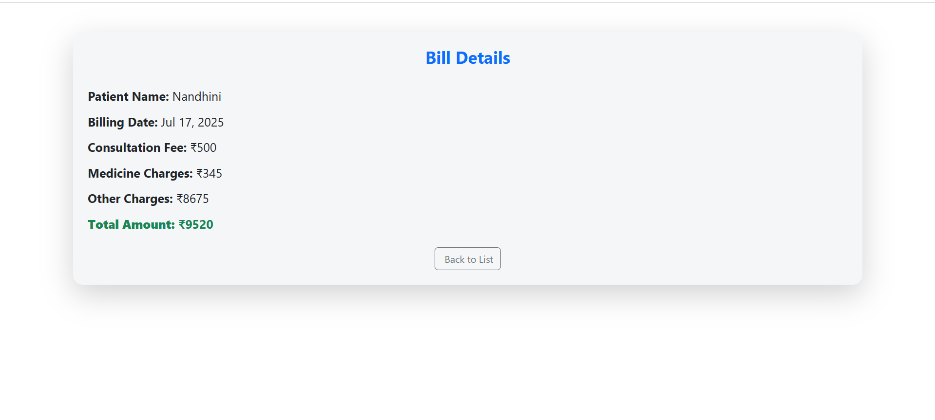
VIEW BILL PAGE:

Slide 23
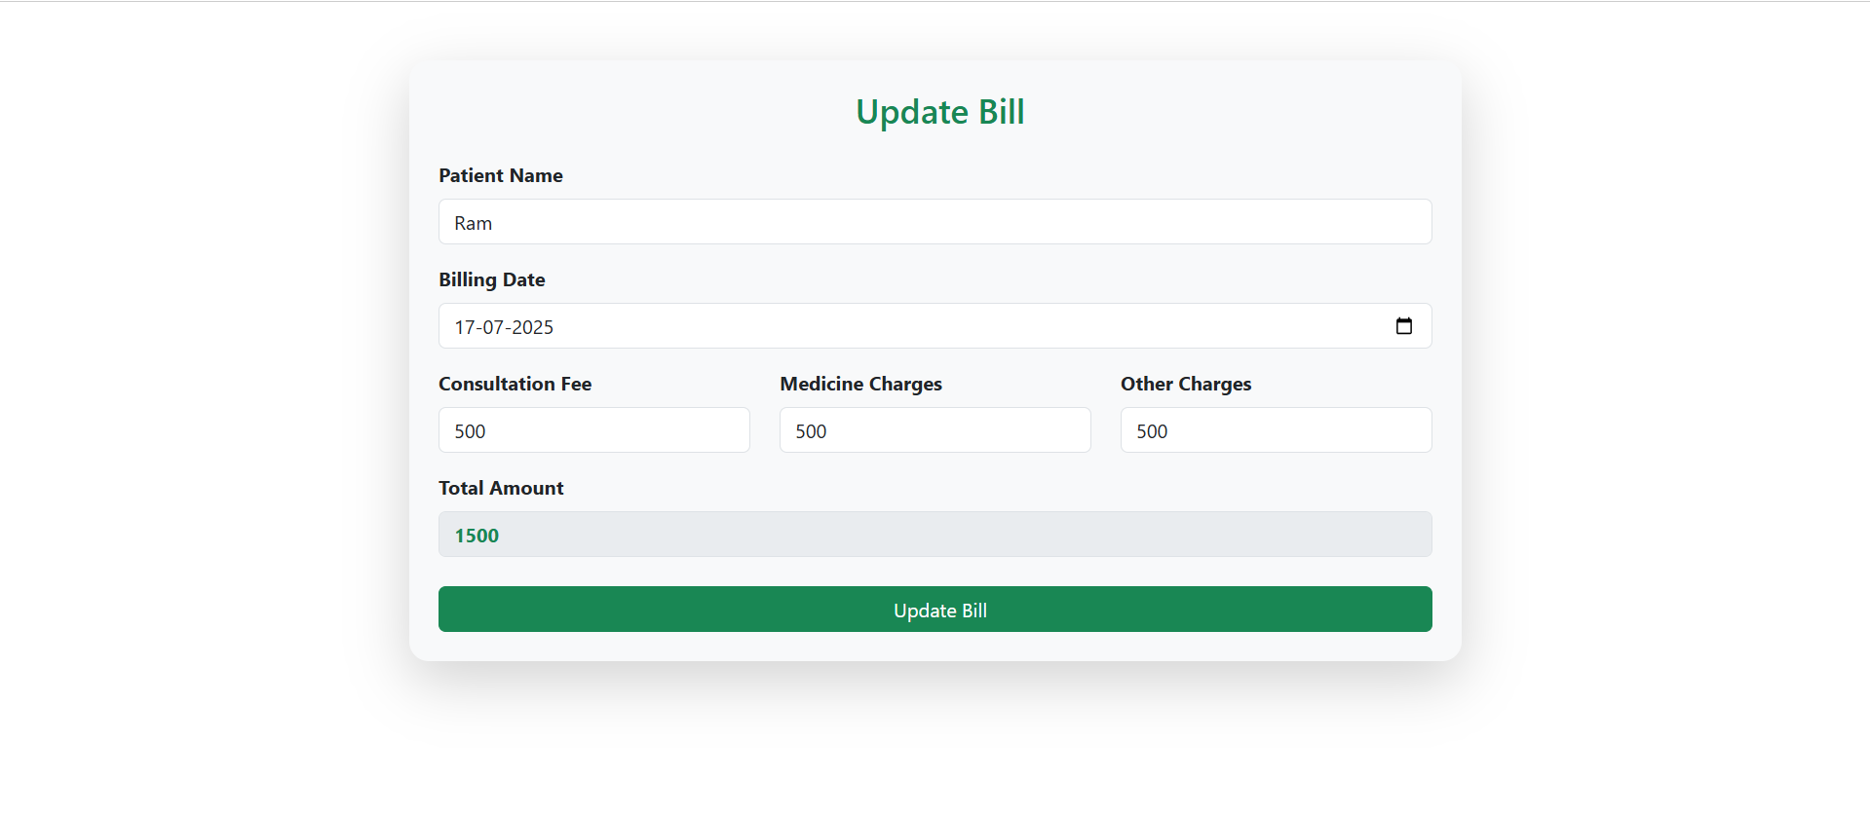
EDIT BILL PAGE:

Slide 24
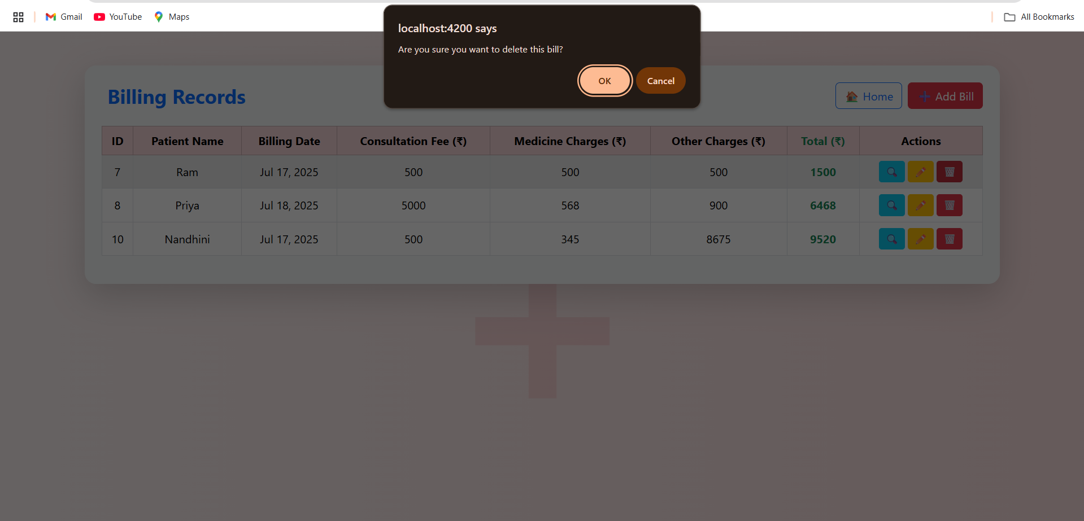
DELETE BILL PAGE:

Slide 25
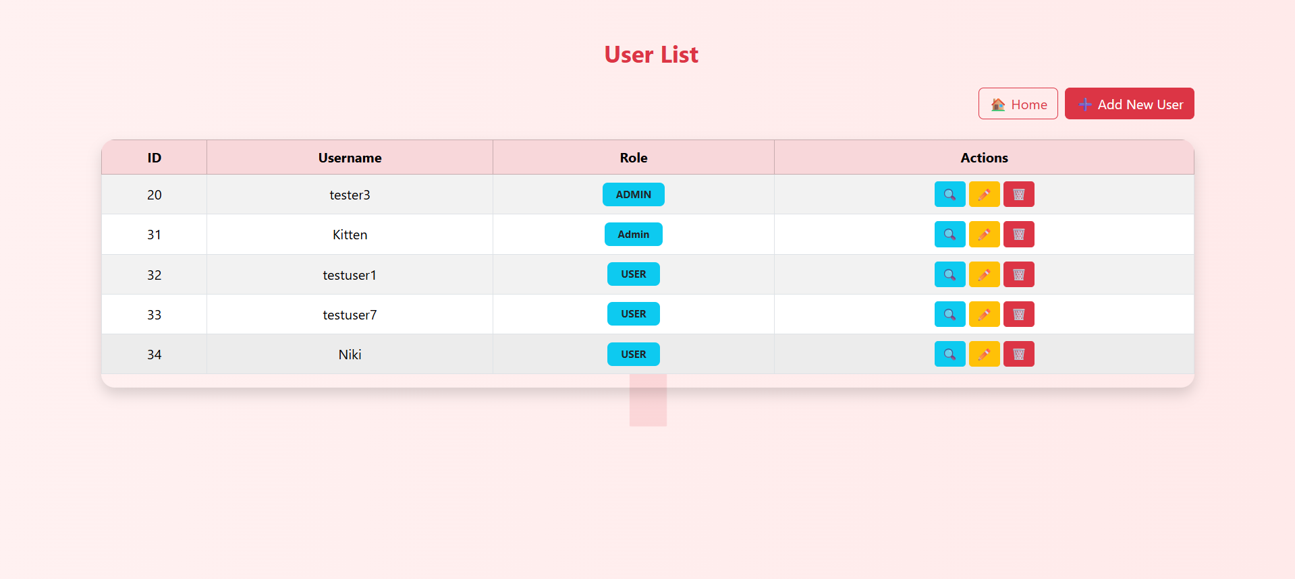
USERS RECORD PAGE:

Slide 26
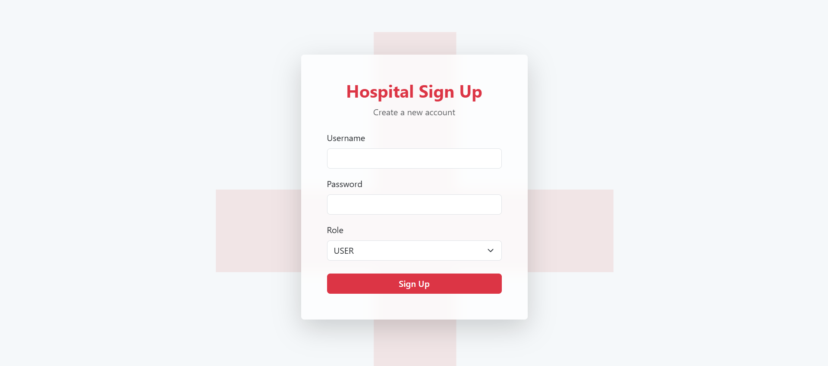
ADD NEW USER PAGE:

Slide 27
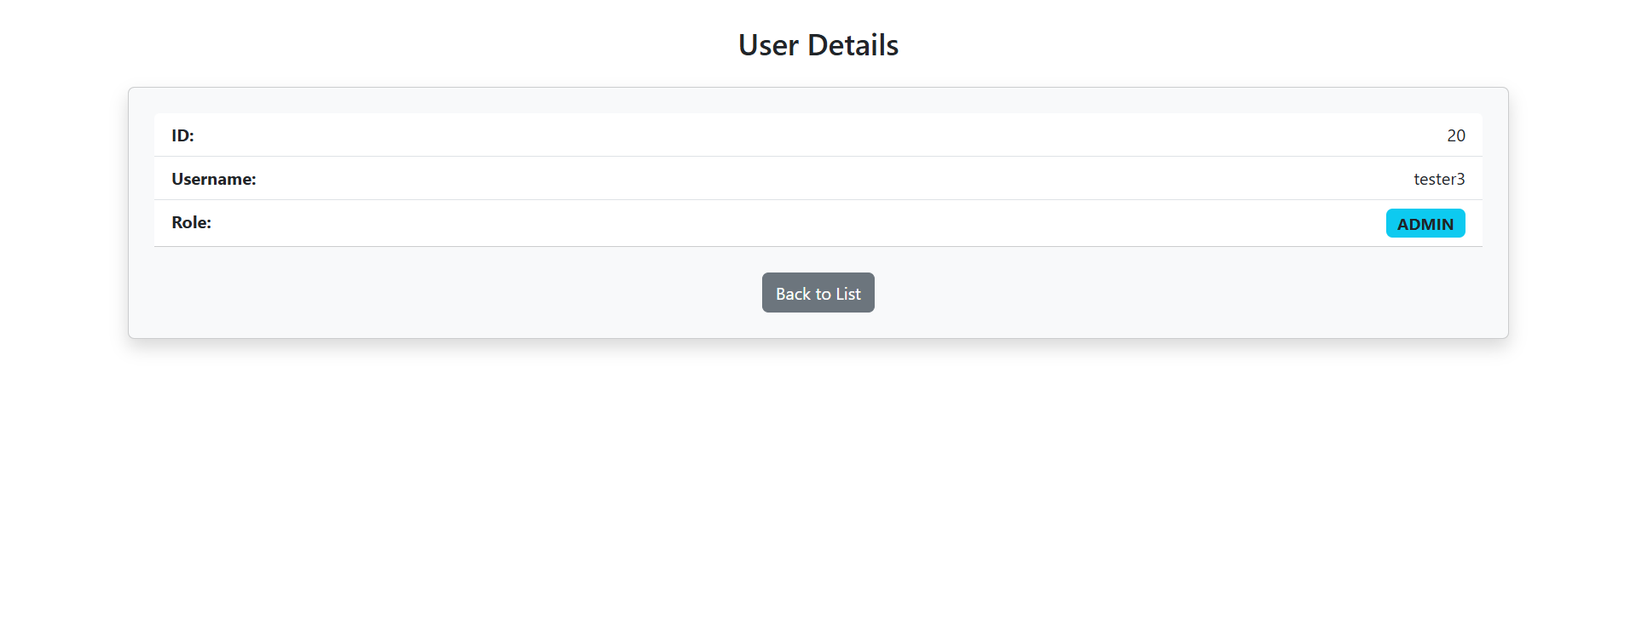
VIEW USER PAGE:

Slide 28
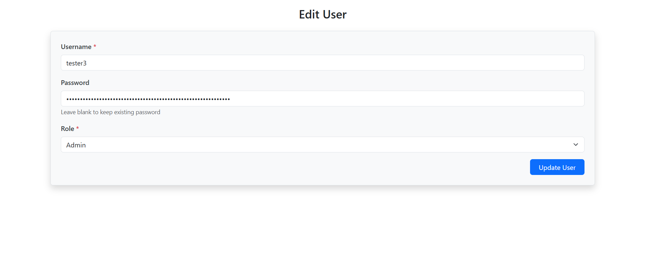
EDIT USER PAGE:

Slide 29
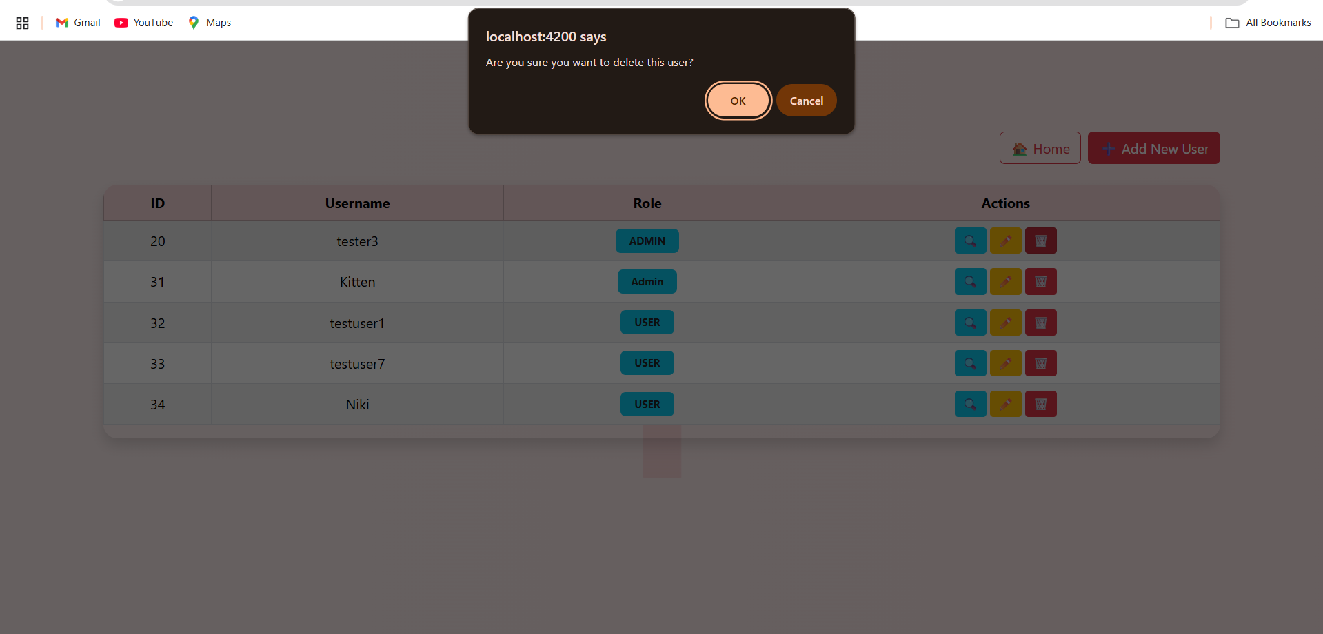
DELETE USER PAGE:

